Slide 1
HxH Tracking System
Chenyu

Slide 2
Overview
User groups: Supervisors and Administrator.
Three Main functions: 1. Hourly automatically produce and record data. 2. able to stop at any time to change over 3. Generate reports
How to use it:
log in or you might need to register a new user.
If you want to check report, please click “Reports”
If you want to add/edit a part/cell number, please click “Parts Maintenance”
If you add/edit an employee, please click “Operators Management”
You can check each buildings status in “Heat Map” page.
Go to “Chat” page if you find any bug or have any comment.
Don’t forget log out

Slide 3

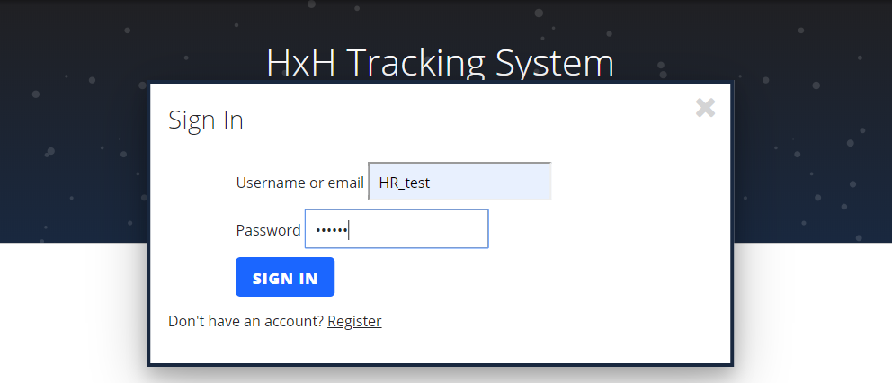
Log in & Register
Got to home page and click “Login/Signup” label, then you can either log in or click “Register” to create a new account.

Slide 4
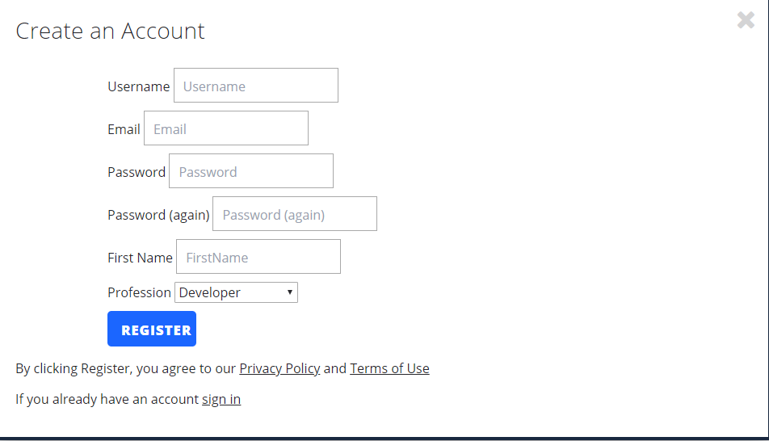
Sign up

Slide 5
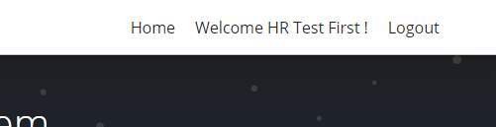
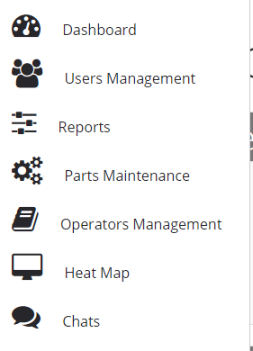
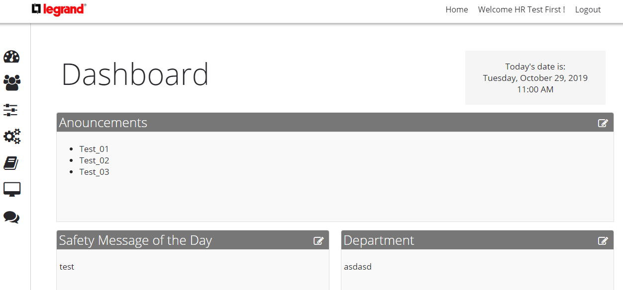
Once you logged in, you can click welcome label to go to the “Dashboard” page. Check your left side, you can go to corresponding pages by clicking these tabs.

Slide 6
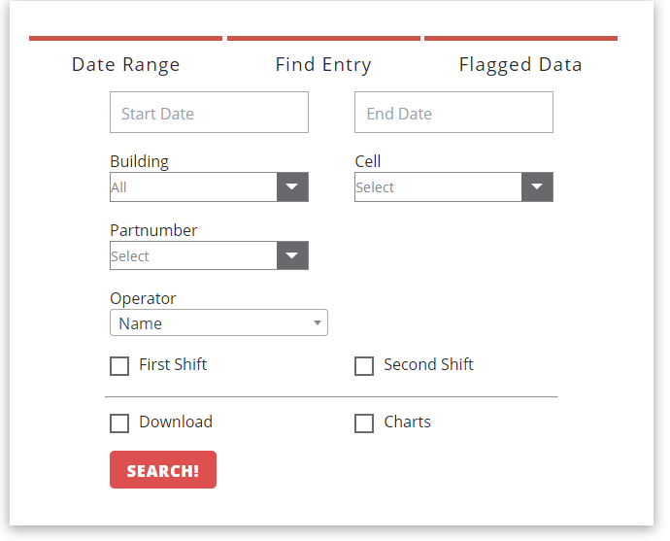
Reports
“Report” page consists of 3 parts: “Date Range”, “Find Entry” and “Flagged Data”. “Report” page will create a neat conclusion with charts and tables based on these constrains; “Find Entry” will let you search a specific record by entering the _id’; “Flagged Data” will let you to find all flagged data in one time range

Slide 7
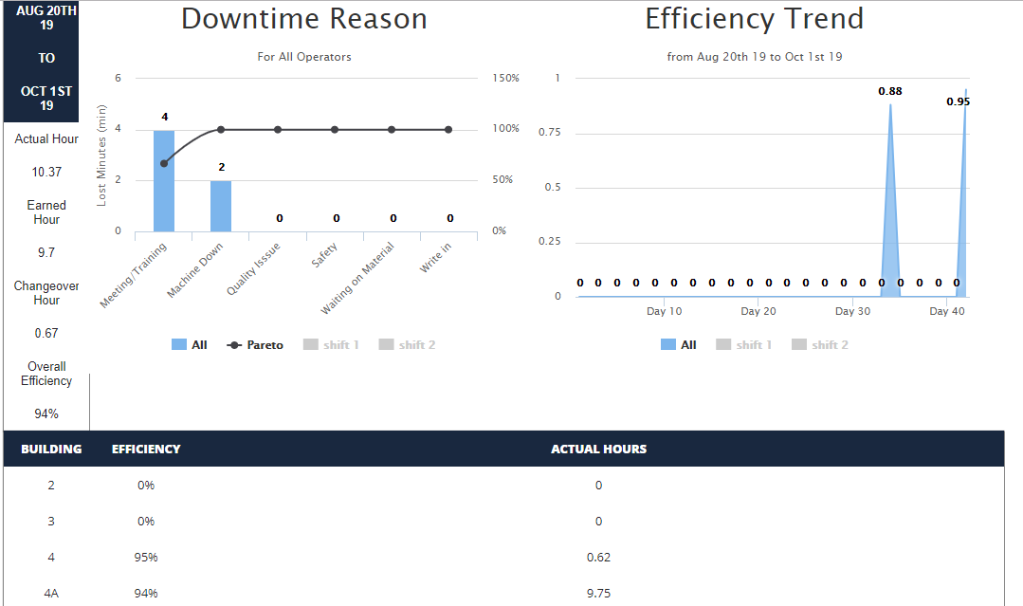
Reports-overview

Slide 8
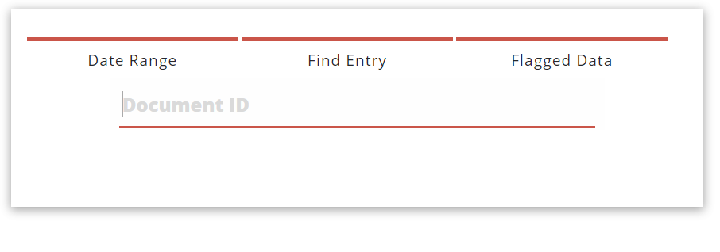
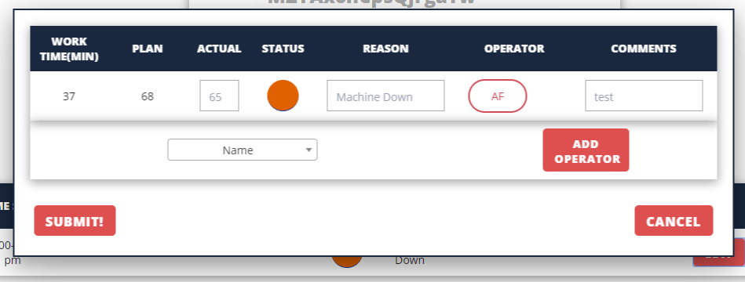
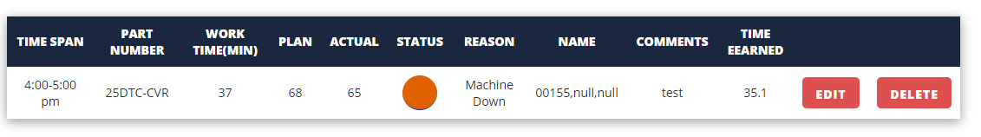
Find Entry
You can copy the “_id” to find entry page to search a specific document if you want to edit/delete it.

Slide 9
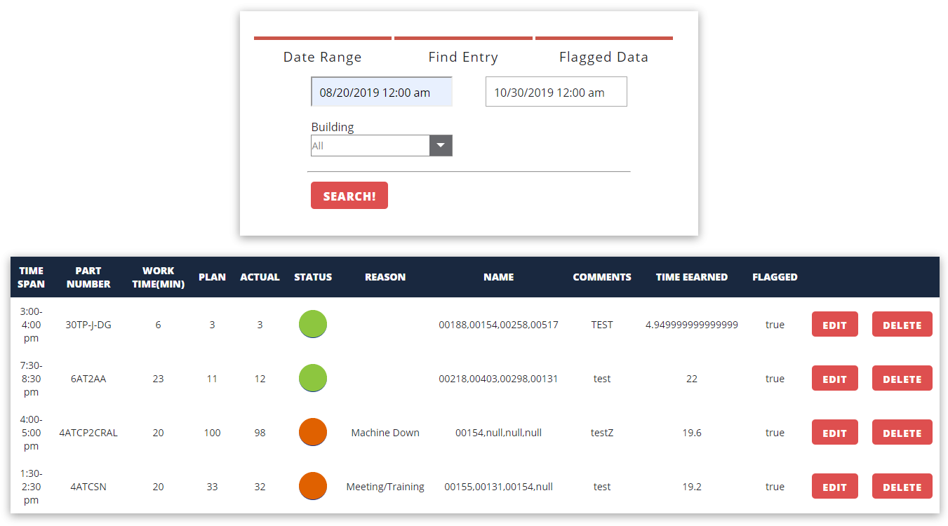
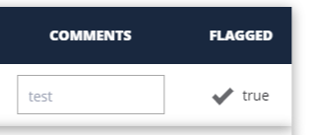
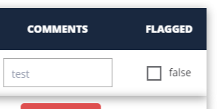
Flagged Data
The functions are almost the same in “Flagged Data” section, except you can unflagged toggle by clicking the check box here.

Slide 10
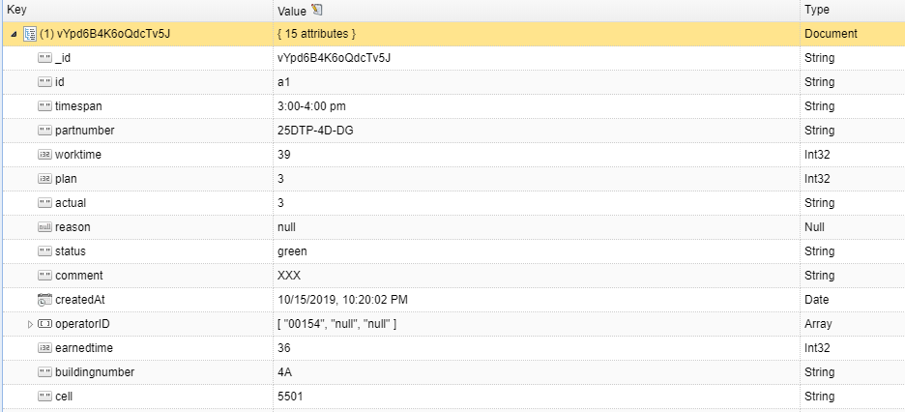
Data Structure

Slide 11
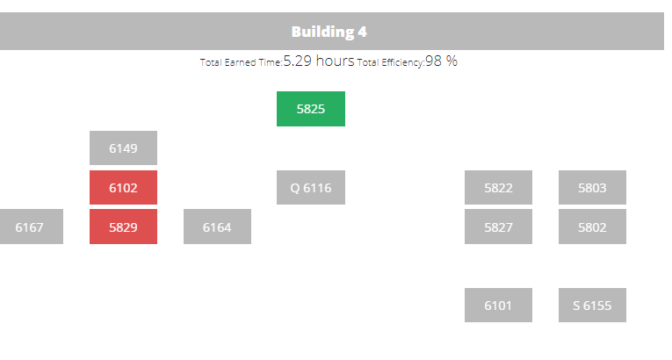
Heatmap
Heat Map will show the current status within today.
Red means there are more red status records than green.
Green means there are less records are in red status
Q means “Quality flag”

Slide 12
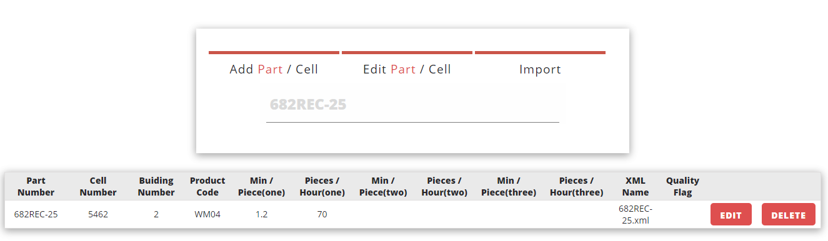
Add/Edit Parts/Cells
If you need to maintain part/cell, you can go to “Parts Maintenance” page. Note that click tab twice will switch the part/cell mode.

Slide 13
Supplementary
All the work times are scaled to fit in the schedule.
For some parts that have “zero Min per Piece”, the value is set to be the default value: “11.1”

Slide 14
Thank you!

